Slide 1
IOLAB
Module 3- Lec 1
Web Architecture & Intro to Frameworks

Slide 2




Map
Getting Started
Front End
Back End
Advanced Topics
Introduction
Fundamentals
Git
Command Line
HTML
CSS
Responsive Design
JavaScript & jQuery
Web Frameworks
Architecture
Database Design
APIs
Visualization
Security
Deployment
Notes:
This is the course map for IOLab 2016
We have packaged the course in f
Open up netflix and utube
our modules

Slide 3
Map
Getting Started
Front End
Back End
Advanced Topics
Introduction
Fundamentals
Git
Command Line
HTML
CSS
Responsive Design
JavaScript & jQuery
Web Frameworks
Architecture
Database Design
APIs
Visualization
Security
Deployment
Notes:
This is the course map for IOLab 2016
We have packaged the course in four modules

Slide 4
Today
Recap : Front end key takeaways
Part 1 : Web Architecture
Part 2 : Web frameworks
Part 3 : Lab – run your own web server

Slide 5
At End of the day
You will know
Resource locators, identifiers and names
DNS
Single and Multi server models
Load balancing
NGINX
Content Delivery Network
Akamai
Run your own web server
Learn about frameworks

Slide 6
Key takeaways so far
Lecture 3 – HTML
HTML is like the skeleton of a web page – it contains its content and gives it structure and meaning with hierarchically-nested, semantic tags
Try to be as semantic as possible, but don’t let it hold you back or force you into awkward code
Your browser creates and renders a virtual model of your HTML code called the Document Object Model (DOM)
Lecture 4 – CSS
CSS is like the skin on top of the HTML skeleton – it gives a web page its layout and visual styling
If architected correctly and CSS is separate from HTML, the same underlying content can be styled in multiple ways
CSS works by selecting DOM elements based on their element type, class, or id
Three important concepts in CSS are the cascade, inheritance, and the box model

Slide 7
Key takeaways so far
Lecture 6 – Intro to JS
JavaScript is a client-side scripting language that makes web pages interactive and dynamic by manipulating the DOM
Select DOM elements similar to CSS, selecting by element type, class, or id
JavaScript has function-level scope (as opposed to block-level), similar to Python
Variable names and function declarations are hoisted to top of scope
Lecture 8 – jQuery
jQuery is a library written in JavaScript that makes things like DOM manipulation, animations, and Ajax easier with less code
Anything you can do in jQuery you can do in JavaScript, but it might be more verbose
Attached event handlers with the .on() method

Slide 8
Web Architecture
Part 2

Slide 9


Web helps you access resources
Find the resource
Access the resource
Notes:
Lets define the web in a very simple way
The web or the internet allows you to access remote resources - remote resources that you don’t have on your local machine
So the two things at play are : finding or locating the resource. And then when you have found the resource, use it the way you want it
Now what makes this difficult is there is not one single resource type. – next slide

Slide 10
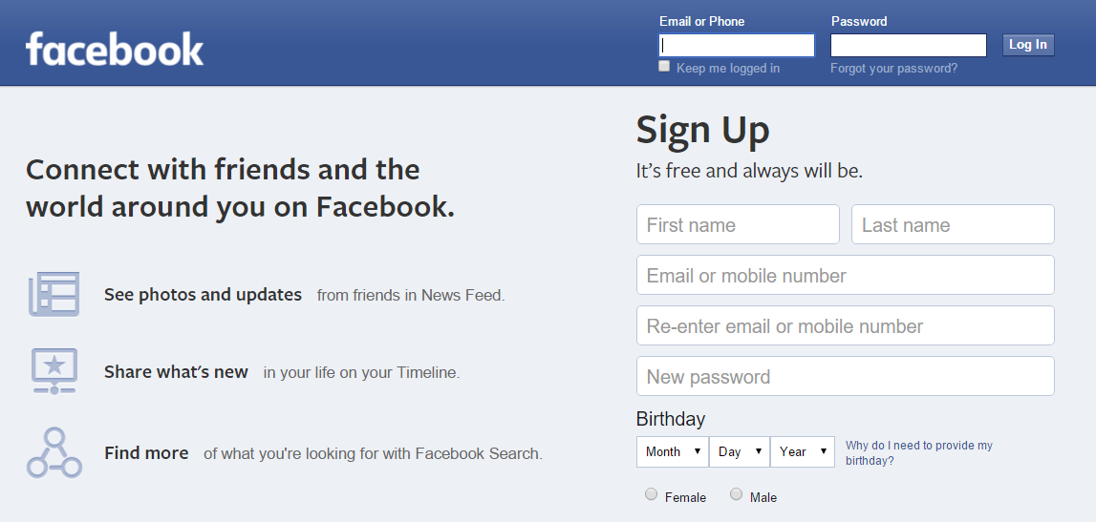
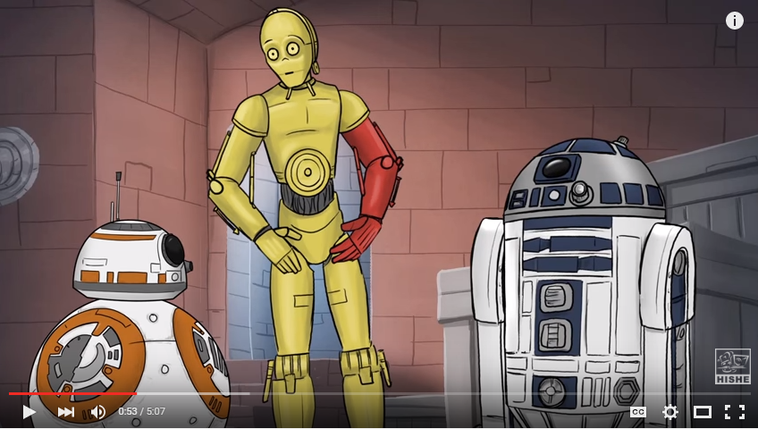


Many types of resources
Notes:
You have web pages..which are the most popular resource you consume.. Then you have videos , images, files , docs and so on..
The way you find or even access these resources differs depending on the type of the resource. Lets look into how we find resources and then access them

Slide 11
Finding Resources : URI vs URL vs URN
URI
Uniform Resource Identifier
nic.funet.fi
URL
Uniform Resource Locator
ftp://nic.funet.fi
URN
Uniform Resource Name
urn:oasis:names:specification:docbook:dtd:xml:4.1.2
How to access the resource (Also an identifier)
Identifies the resource
Just a name under a specification
Notes:
There are three major things at play here. The first is identifying your resource..so you have something called as the URI … a standard convention to differentiate between resources. However the uri by itself may not be enough for you to access the resource..which is why you need something called as the url. The url identifies the resource but also tells you what exactly is the resource and how do you access it
Can you tell me the difference between these two
URI Vs URL Vs URN
URI – Used to identify a resource
May/ May not locate the resource
URN – Used to Name a resource
May or may not locate the resource
urn:oasis:names:specification:docbook:dtd:xml:4.1.2
URL – Used to locate a resource
Locates the resource
All URLs are URIs (Every resource has a unique location)
RFC 3986
https://www.w3.org/TR/uri-clarification
http://www.ietf.org/rfc/rfc3986.txt
https://danielmiessler.com/study/url-uri/

Slide 12
Uniform Resource Locator
Protocol://hostname/more_information
http : // catbook.com / felixthecat / photo23
Notes:
We name resources on the Web with URIs.
We interact with resources via URIs and over protocols such as HTTP.
We use common data representations such as HTML or XML.
We use metadata, from both the protocol and data representation, to understand how to process representations.
We use annotations, encoded in markup and links, to discover new information such as related resource locations on the Web.
Protocol specifies how information is transferred
HTTP is the most common web protocol
Hyper text transfer protocol
FTP : File Transfer protocol
SMTP, Telnet , Gopher etc..

Slide 13
Uniform Resource Locator
Protocol://hostname/more_information
What’s the resource ?
How do I access it ?
File ? FTP
Web Page ? HTTP
Email ? SMTP
Notes:
Protocol specifies how information is transferred. Its just a series of steps that tell you how to request a resource and how do you interpret the response. The resource could be a file server or a web page or a mail exchange server
HTTP is the most common web protocol
Hyper text transfer protocol
FTP : File Transfer protocol
SMTP, Telnet , Gopher etc..
Try out nic.funet.fi in ftp and http

Slide 14
Uniform Resource Locator
Protocol://hostname/more_information
Where the server resides
Human address
Catbook.com
IP Address
123.243.112.286
Notes:
The hostname just tells you where and what is your server. Could be either of two things-damn we are obsessed with cats

Slide 15
Uniform Resource Locator
Protocol://hostname/more_information
Path
http://timeatlas.com/uploads/FT23r.png
Query Strings
http://google.com/search?query=mysearch
Query Parameters
http://google..?query=mysearch&username=adityamishra&user_zip=94703
Notes:
The last part of the url is a string which tells your host – your server which resource to give back to you.. Now this can happen in 3 ways
First one is really simple :
Path : talk about netflix
Imgcolor in google iimage search
https://www.youtube.com/watch?v=6LZM3_wp2ps
https://www.youtube.com/v/6LZM3_wp2ps

Slide 16
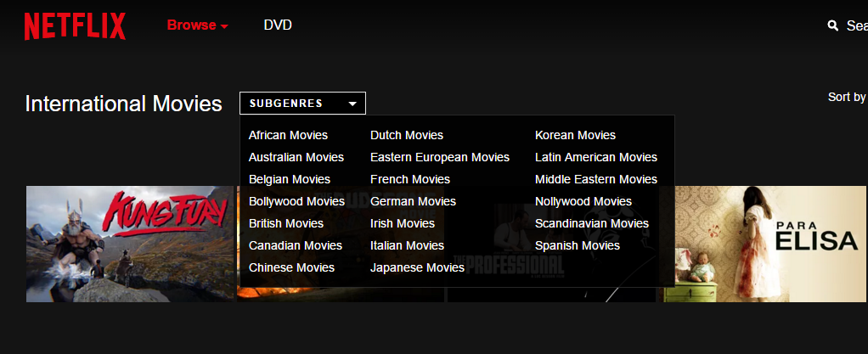
Netflix’s categories
Notes:
http://whatsonnetflix.com/netflix-hacks/the-netflix-id-bible-every-category-on-netflix/3/

Slide 17
Netflix’s hidden categories netflix.com/browse/genre/
Sentimental African American dramas - 2301
Israeli political movies – 4711
Inspiring teen movies – 1349
Indian movies from the 1980s -3634
Gritty Chinese Action & Adventure – 2666
Critically acclaimed visually striking gory movies – 781
And hundreds more …. !!!!
Notes:
http://whatsonnetflix.com/netflix-hacks/the-netflix-id-bible-every-category-on-netflix/3/

Slide 18
Domain Name System - Basic
Catbook server
Catbook.com
DNS
223.211.768.55
www.Catbook.com = 223.211.768.55
Notes:
The internet unpacks human names into machine names
You remember human names but the internet understands machine addresses
The Domain Name System (DNS) protocol is an important part of the web's infrastructure, serving as the Internet's phone book: every time you visit a website, your computer performs a DNS lookup. Complex pages often require multiple DNS lookups before they start loading, so your computer may be performing hundreds of lookups a day. (google developers)
http://www.howtogeek.com/howto/7406/speed-up-your-web-browsing-with-google-public-dns/

Slide 19
Try it out!
Google has its own publicly accessible DNS server
Change your DNS server to point to Google
Notice any speed difference(try accessing a never before site)
https://developers.google.com/speed/public-dns/docs/using

Slide 20
Single Server model
Catbook server
DNS
www.Catbook.com.
223.211.768.55
www.Catbook.com = 223.211.768.55
Notes:
This is the most popular setup of a website currently on the internet..in terms of numbers. Most websites you see are deployed on one server. That one server has an ip address which rarely changes..and all the dns servers in the world have this mapping. Whenever you change this ip address, you also change the dns entry..its really simple..questions..??

Slide 21
Scaling up
Catbook server
DNS
www.Catbook.com = 223.211.768.55
Notes:
The challenge is when you scale up..!

Slide 22
Scaling up
Catbook servers
www.Catbook.com.
74.211.768.55
DNS
63.211.7.51
www.Catbook.com = ?
113.2.56.234
Notes:
The Domain Name System (DNS) protocol is an important part of the web's infrastructure, serving as the Internet's phone book: every time you visit a website, your computer performs a DNS lookup. Complex pages often require multiple DNS lookups before they start loading, so your computer may be performing hundreds of lookups a day. (google developers)

Slide 23
Scaling up
Catbook servers
www.Catbook.com.
Proxy
74.211.768.55
DNS
63.211.7.51
113.2.56.234
Notes:
The Domain Name System (DNS) protocol is an important part of the web's infrastructure, serving as the Internet's phone book: every time you visit a website, your computer performs a DNS lookup. Complex pages often require multiple DNS lookups before they start loading, so your computer may be performing hundreds of lookups a day. (google developers)

Slide 24
Scaling up
Catbook servers
www.Catbook.com.
Proxy
74.211.768.55
DNS
63.211.7.51
164.25.93.87
www.Catbook.com = 164.25.93.87
113.2.56.234
Notes:
The Domain Name System (DNS) protocol is an important part of the web's infrastructure, serving as the Internet's phone book: every time you visit a website, your computer performs a DNS lookup. Complex pages often require multiple DNS lookups before they start loading, so your computer may be performing hundreds of lookups a day. (google developers)

Slide 25
Load Balancing
NGINX is a popular load balancer
Distribute load across multiple servers
Also add (possibly) a secure firewall layer
Algorithms
Round Robin (Default)
Least Connected
IP Hashing
May not solve geographic challenges

Slide 26

Round Robin
Server 1
Server 2
Server 3

Slide 27
Least Connected
Server 1
200 connections
Server 2
123 connections
Server 3
312 connections

Slide 28
IP Hashing
Why would you need this ?
Server 1
200 connections
Server 2
123 connections
User X
22.124.65.1
Server 3
312 connections
22.124.65.1 always Server1
Notes:
Ip hashing, runs an algorithm that converts your clients ip address to one of your server’s ip address
Whenever you

Slide 29
Deconstructing Load Balancing
What addresses to listen to ?
What addresses to send to ?
What protocol ?
Catbook.com

Slide 30
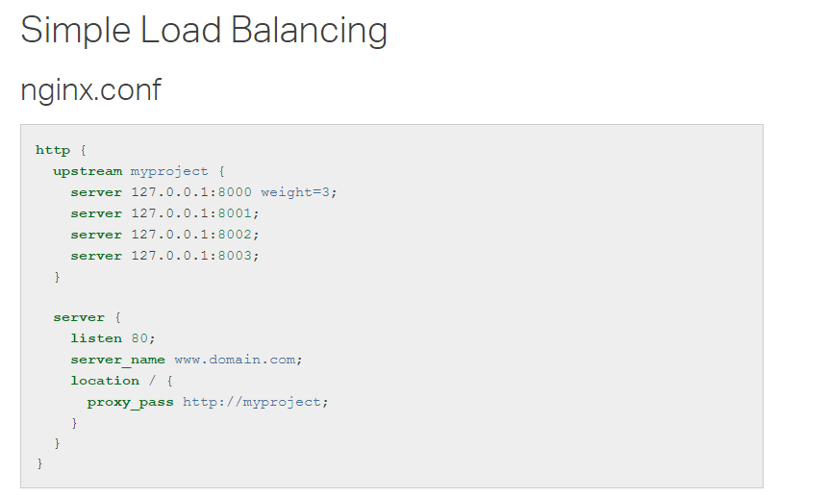

Slide 31
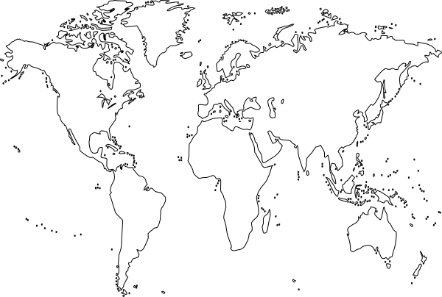
Result : Network Congestion
Notes:
https://anuragbhatia.com/networking/akamai-cdn-and-dns-resolution-analysis/

Slide 32
Result : Less Network Congestion
Notes:
However, if a customer uses Akamai, the domain name of the URL is translated to the IP address of an edge server owned by Akamai. Akamai then delivers the Web content to the customer’s users, without it ever having to touch the customer’s servers. Akamai is able to do this by storing copies of frequently used elements such as HTML, CSS, software downloads, and media objects from customers’ servers.[http://preethikasireddy.me/?p=231]

Slide 33
Content Delivery Networks – a necessary evil
WHY
WHY NOT
Lower packet loss
Performance ++
Distributed Data
Not 1 single Pt of failure
More maintenance
More worry about hacks
They have your data
CDN Fails-more routing
Notes:
Data packets are dropped all the time. The more they travel, the riskier losses get

Slide 34
Part 2
Web Frameworks

Slide 35

HTML and other stuff
Server
Port:8080
HTTP Request
HTTP Response
Notes:
Lets analyze a simple request response
The HTTPprotocol is based on a request-response model. The client (your browser) requests data from a web application that resides on a physical machine. The web application in turn responds to the request with the data your browser requested.

Slide 36
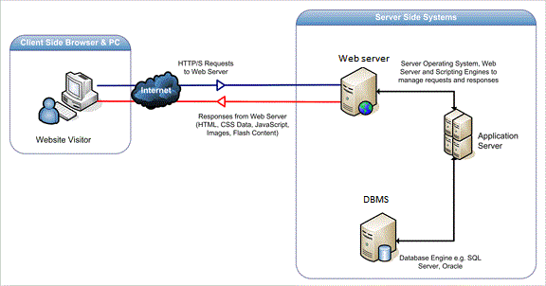
The Server
Notes:
No matter what happens in this whole architecture, you send back html which can be rendered on a browser
So all your processing,logic,calculations..everything which happens is actually hidden from the guys accesing your final content

Slide 37
More about requests
Client requests for resources
Server receives the request
Server inspects the request and parses out the URL
Works to get the right page/file/script
Maintains sessions when needed
Returns resources packed in an HTTP response

Slide 38
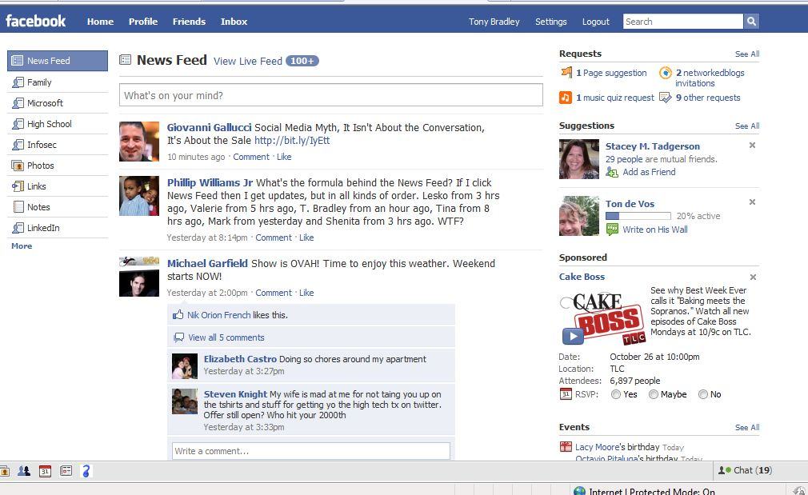
Behind the scenes
Accessing facebook.com/home
Route
Template
Notes:
Let see a simple request
The URL is for the facebook homepage, but it appears with different content for every one
This is called dynamic html generation-producing content on the fly!
A template contains the static parts of the desired HTML output as well as some special syntax describing how dynamic content will be inserted.
When server receives a request for the homepage – it Pull up the home module
The home module parses your username
Contacts the DB and assembles stories for your news feed
Stories are plugged into an HTML page
Sent back to the user

Slide 39
Routing and templating – building blocks
Routing
Each URL is handled by its own logic
The server needs to understand which logic to call based on the requested URL
URL → Corresponding Logic
Templating
Users expect consistent layouts
Each URL has its own design, only the information within it changes
Standard html templates reside within the server
Plugged in with custom info before serving
All frameworks work on the same premise … but use different ways
Focus on your unique application ! And do not boil the ocean!
Notes:
Routing and templating are building blocks

Slide 40
Rails Principles
Don't Repeat Yourself: DRY is a principle of software development which states that "Every piece of knowledge must have a single, unambiguous, authoritative representation within a system." By not writing the same information over and over again, our code is more maintainable, more extensible, and less buggy.
Convention Over Configuration: Rails has opinions about the best way to do many things in a web application, and defaults to this set of conventions, rather than require that you specify every minutiae through endless configuration files

Slide 41
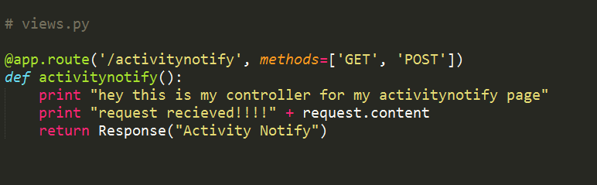
Routing in Flask
Views.py is the python file where you handle incoming requests
Example www.yourserver.com/activitynotify
Notes:
/act/<id>
Def
sessions

Slide 42
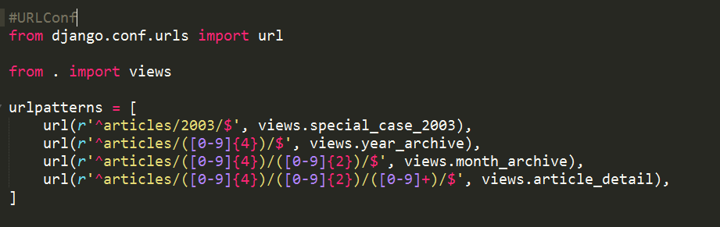
Routing in Django
ROOT_URLCONF Setting > File > looks for the variable urlpatterns
Stops at the first regular expression [Django documentation]
Notes:
A request to /articles/2005/03/ would match the third entry in the list. Django would call the functionviews.month_archive(request, '2005', '03').
/articles/2005/3/ would not match any URL patterns, because the third entry in the list requires two digits for the month.
/articles/2003/ would match the first pattern in the list, not the second one, because the patterns are tested in order, and the first one is the first test to pass. Feel free to exploit the ordering to insert special cases like this. Here, Django would call the function views.special_case_2003(request)
https://docs.djangoproject.com/en/1.9/topics/http/urls/

Slide 43
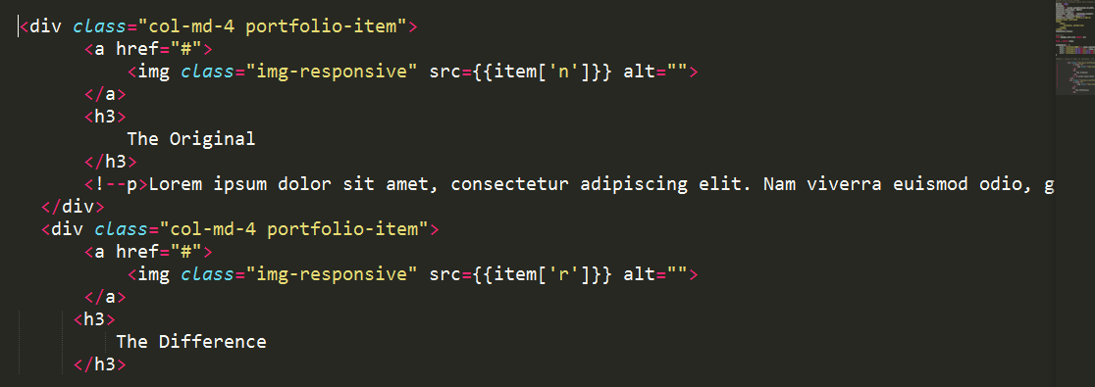
Templating in Flask
A templates folder in your Flask app has all the HTMLs
Example www.yourserver.com/activitynotify

Slide 44
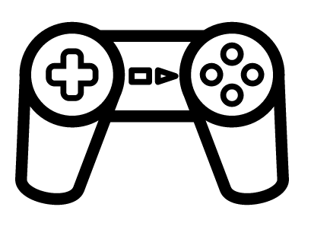

MVC Pattern – architecture of most Frameworks
Model
View
Controller
Notes:
The model represents the data, and does nothing else. The model does NOT depend on the controller or the view.
The view displays the model data, and sends user actions (e.g. button clicks) to the controller. The view can:
be independent of both the model and the controller; or
actually be the controller, and therefore depend on the model.
The controller provides model data to the view, and interprets user actions such as button clicks. The controller depends on the view and the model. In some cases, the controller and the view are the same object
http://www.tomdalling.com/blog/software-design/model-view-controller-explained/

Slide 45
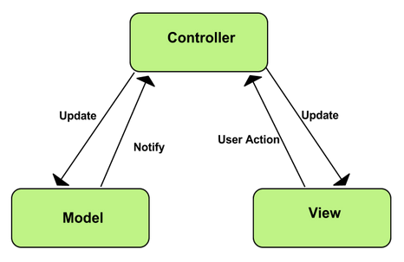
MVC
Courtesy: Google MVC guide

Slide 46
MVC Pattern
Separation of concerns!
Application Logic
Application presentation
Information persistence
The other stuff:
Routing, templating, sessions , HTTP, Networking.. etc
Notes:
https://lostechies.com/derekgreer/2007/08/25/interactive-application-architecture/

Slide 47
Summary – Why Frameworks
Hides all that infrastructure / repetitive code
Helps you focus on application logic instead
Structures whatever you code into modules – for example MVC
Notes:
By now, the purpose of web frameworks should be clear: to hide the boilerplate and infrastructural code related to handling HTTPrequests and responses. Just how much is hidden depends on the framework. Django and Flask represent two extremes. Django includes something for every situation, almost to its detriment. Flask bills itself as a "micro-framework" and handles the bare minimum of web application functionality, relying on third-party packages to do some of the less common web framework tasks.
Remember, though, that at the end of the day, Python web frameworks all work the same way: they receive HTTP requests, dispatch code that generates HTML, and creates an HTTP response with that content. In fact, all major server-side frameworks work in this way (excluding JavaScript frameworks). Hopefully, you're now equipped to choose between frameworks as you understand their purpose.
Posted on Mar 03, 2014 by Jeff Knupp

Slide 48
Lab: A simple server
Download the python script runmyserver.py [Bcourses>IOLab>Files>Labs]
Disable your firewall
Find your IPv4 address
Run the python script
Ask your neighbor to access your URL!!

Slide 49
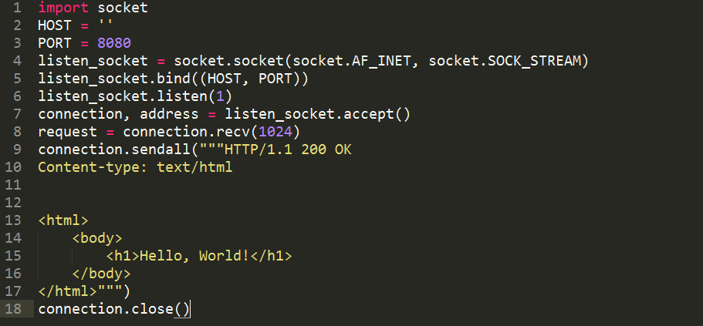
Lab: A simple server

